Slide 1
MANUAL HANDLING
Practical Application

Slide 2
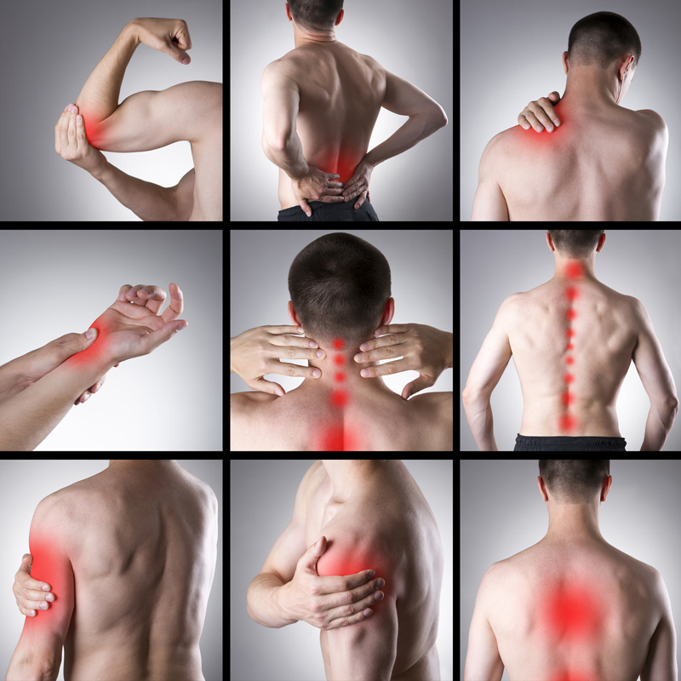
LEARNING OUTCOMES
What is a Manual Task?
What is a Hazardous Manual Task?
How to perform Manual Tasks safely?

Slide 3
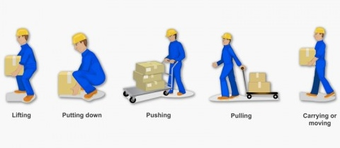
MANUAL TASK DEFINITONS
Manual Task means a task requiring the person to use force to:
Lift, lower
Push, pull
Carry or otherwise move,
Hold or restrain any person, animal or thing.

Slide 4
HAZARDOUS MANUAL TASK DEFINITONS
Hazardous manual tasks are tasks involving any of the following:
repetitive or sustained force
high or sudden force
repetitive movement
sustained and/or awkward posture
exposure to vibration.

Slide 5
HAZARDS FROM MANUAL HANDLING
Hazards that arise from manual tasks generally involve a complex interaction between a worker and:
the work tasks and how they are performed
the tools, equipment and objects handled, and
the physical work environment.
You should always report manual handling hazards so they can be eliminated or controlled to reduce the chance of injury

Slide 6
Training Questions
A manual task is which of the following?
Laying down while at work?
Lift, lower, push, pull, carry or otherwise move or hold or restrain any person, animal or thing?
Sitting at your desk?

Slide 7
Training Questions
A Hazardous Manual Task is which of the following?
repetitive or sustained force
high or sudden force
repetitive movement
sustained and/or awkward posture
exposure to vibration.
All of the above

Slide 8
INJURIES LINKED WITH MANUAL HANDLING
Injuries most commonly linked with hazardous manual tasks are musculoskeletal disorders, which occur in two ways:
Gradual wear and tear to joints, ligaments, muscles and inter-vertebral discs caused by frequent or prolonged periods of muscular effort associated with repeated or continuous use of the same body parts, including static body positions.
Sudden damage caused by strenuous activity, or unexpected movements such as when loads being handled move or change position suddenly.

Slide 9
PREVENTION
Understanding of what constitutes a hazardous manual handling task.
Identification and control of the risks
Correct lifting techniques
Use of Mechanical Aids
Reporting of faulty equipment
Reporting of symptoms (early)

Slide 10
RECOMMENDED WEIGHT LIFTS IN RANGE

Slide 11
The Disc’s Response to Pressure

Slide 12
Training Questions
What are main injury prevention techniques that should be used?
Understanding of what constitutes a hazardous manual handling task.
Identification and control of the risks
Correct lifting techniques
Use of Mechanical Aids
Reporting of faulty equipment
All of the above

Slide 13
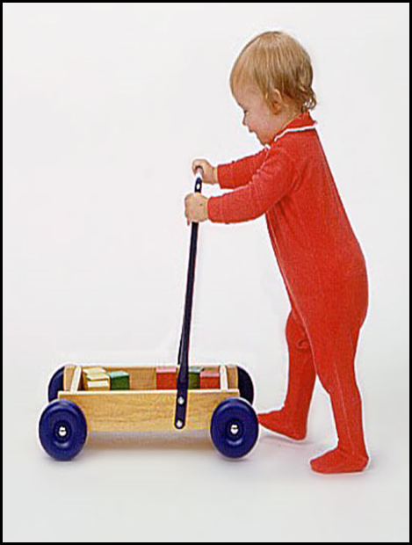
MANUAL HANDLING CHILD’S PLAY
For children, correct lifting, carrying and manual handling techniques come naturally.
It’s only as we get older that we begin to adopt unnatural and potentially injurious manual handling habits.

Slide 14
MANUAL HANDLING METHODS
There are different methods for manual handling. These depend on the manual handling task you have to do.
Pushing/Pulling Lifting Pushing Carrying

Slide 15
PREPARING FOR A MANUAL HANDLING JOB
There are a few easy steps you can follow to make sure that you're ready for a manual handling task.
Warm up
Just as you'd warm up before taking part in sports or exercise, you need to warm up before you handle a heavy load.
Assess the task
Plan the move

Slide 16
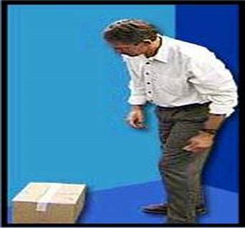
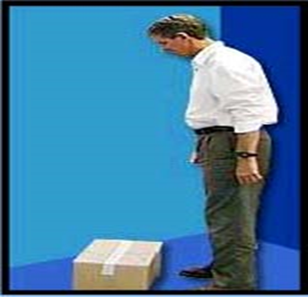
THE 10 STEPS FOR LIFTING
Step 1: Assess the load.
Step 2: Get close to the load.

Slide 17
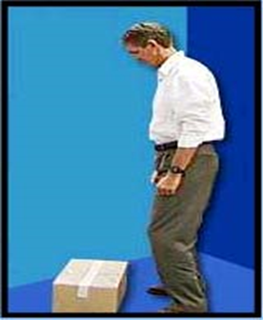
THE 10 STEPS FOR LIFTING
Step 3: Set your feet apart for balance.
Step 4: Relax your knees.

Slide 18
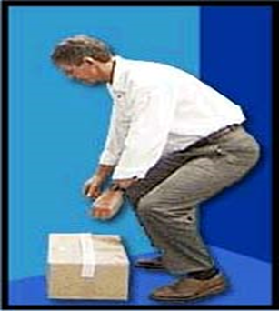
THE 10 STEPS FOR LIFTING
Step 5: Lower your body and bend your knees
Step 6: Lower your head.

Slide 19
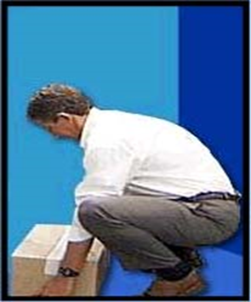
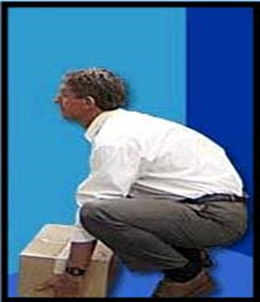
THE 10 STEPS FOR LIFTING
Step 7: Get a firm grip.
Step 8: Raise your head and look ahead.

Slide 20
THE 10 STEPS FOR LIFTING
Step 9: Straighten your legs.
Step 10: Lift, then turn your feet before walking.

Slide 21
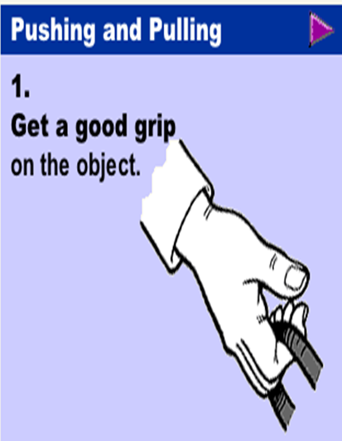
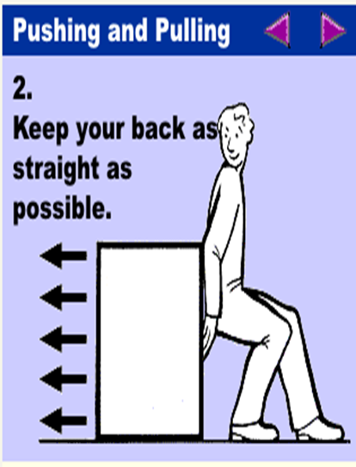
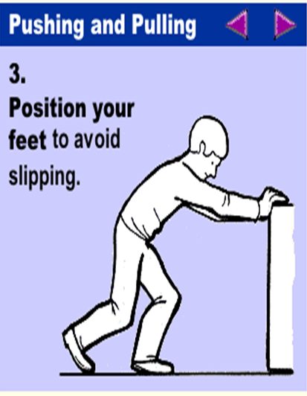
PUSHING & PULLING METHODS
Push rather than pull when able as when you pull you arch your back and do not use your thigh muscles. Which can lead to increase risk of injury.

Slide 22
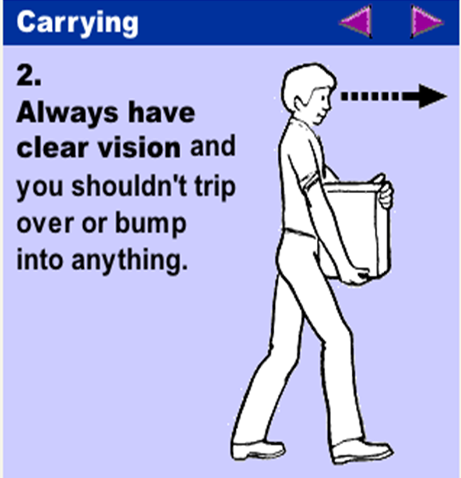
CARRYING

Slide 23
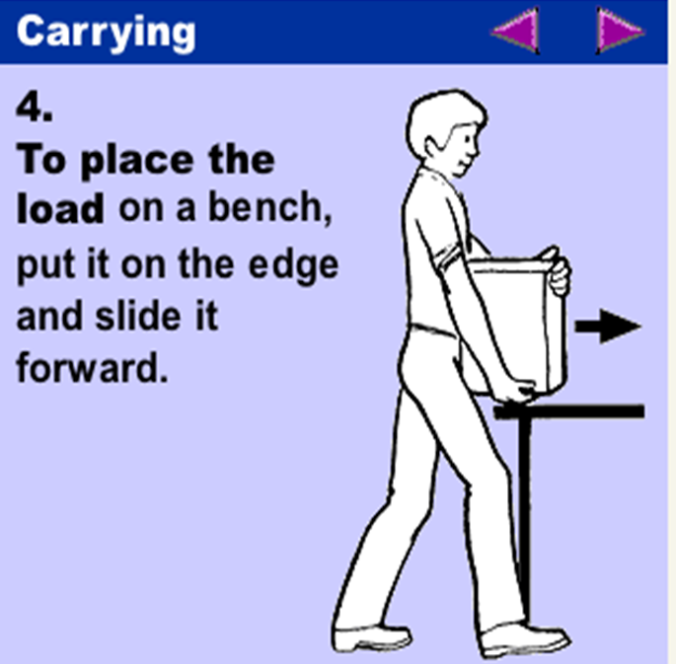
CARRYING

Slide 24
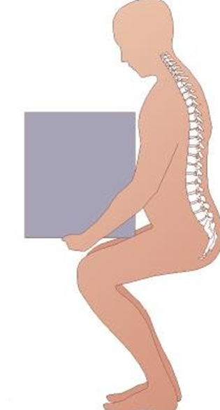
THE POWER POSITION - (SEMI SQUAT LIFTING)
Position your feet shoulder width apart.
Where possible, place one foot slightly forward.
Bend your knees halfway.
Tuck in chin.
Bend at the hips (not at the waist) and reach for object on the floor.
If possible, ensure load is between your legs and close to your body.
Maintain the curves of your spine.
As you straighten legs to lift, raise your head and look forward.

Slide 25
Training Questions
Which of the following is the 10 Steps For Lifting?
Assess the load; Get close to the load; Set your feet apart for balance; Relax your knees; Get a firm grip; Raise your head and look ahead; Straighten your legs; Lift, then turn your feet before walking.
Assess the load; Get close to the load; don’t bend the knees; Lift with your back;
Assess the load; Get close to the load; Set your feet apart for balance; Relax your knees; loosen your grip; Raise your head and look ahead; Straighten your legs; Lift, then start walking;

Slide 26
MOVING HEAVY LOADS WITH MECHANICAL AIDS
Mechanical aids reduce physical effort, making manual
handling easier and safer.
Check for the availability of mechanical aids before lifting or moving loads.
Select the right equipment to complete the task.
Do not operate any equipment if you are not trained to use it.
Visually inspect the equipment for any defects such as loose wheels or damaged platforms before use. Put onto a Preventative Maintenance Plan.
Complete any documented pre-start checks where required.
Maintain the equipment in good and safe operating condition.

Slide 27
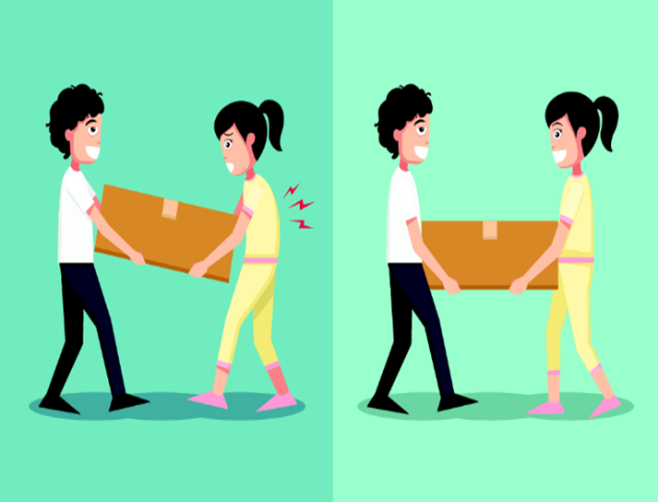
MOVING HEAVY LOADS
You may need to move loads that are too heavy for you to lift or carry. In these cases, you may need to use some of these methods:
2 person lift : Work with someone to carry the load.
Ensure the person is around your height
Plan the lift.

Slide 28
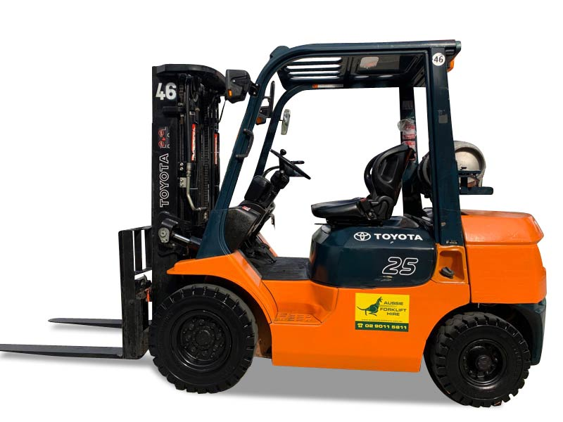
TYPES OF MECHANICAL LIFTING AIDS
Pallet Jack
Sack Truck
Furniture lifting Straps
Platform Trolley
Forklift

Slide 29
Training Questions
Do mechanical aids reduce physical effort, making manual handling easier and safer?
True
B. False

Slide 30
REMEMBER
Know your limitations
Assess the task
Use correct manual handling techniques
Use mechanical aids where possible
Report faulty equipment – Hazard Report Form
Report early symptoms – Report to your Supervisor and / or complete Incident Report Form

Slide 31
QUESTIONS?

